Slide 1

Department of Computer Science and Engineering
PREDICTION ANALYSIS USING SUPPORT VECTOR MACHINE IN CARDIOVASCULAR AILMENTS
Date: 29 May 2021
O.VEDA VARSHITHA : 17WH1A0518
G.NAGA LAXMI PRASANNA : 17WH1A0523
P.ANJALI : 18WH5A0504
Internal Guide: Ms. M SHANMUGA SUNDARI
Designation: Assistant Professor
Department of Computer Science & Engineering
BVRIT HYDERABAD College of Engineering for Women

Slide 2

Why Should I Study this course?
ABSTRACT
Examples
Problem Statement:
Heart disease is one of the most significant causes of mortality in today’s world. Heart disease proves to be the leading cause of death for both men and women. Deaths due to heart disease have become very common and medical professionals working in the field of heart disease have their limitations, they cannot predict the chance of getting heart disease up to high accuracy.
Project Objective:
To improve Heart Disease prediction accuracy and predict the 10 years risk of coronary heart disease, bases on the data available. Stochastic gradient descent, Linear regression and SVM algorithms are applied and comparative analysis will be done to get the model with the best accuracy.
BVRIT HYDERABAD College of Engineering for Women

Slide 3
ARCHITECTURE
Dataset
Attribute
Selection
Pre-processing on data
Classification
Algorithm
Support vector machine
Stochastic gradient descent
Logistic regression
Patient Details
Disease Prediction
Accuracy Measure
BVRIT HYDERABAD College of Engineering for Women

Slide 4
TECHNOLOGY STACK
Machine Learning
Python Language
Packages used:
numPy : To work with arrays.
Pandas : To work with CSV files and data frames.
Matplotlib : To create charts using pyplot.
Train_test_split : To split the dataset into training and testing data.

Slide 5
SYSTEM SPECIFICATIONS
ENVIRONMENT | SPECIFICATIONS
HARDWARE | Processor - Intel Core i5 Memory(RAM) - 8 GB Storage – I TB
SOFTWARE | Python OS - Windows 10 Google Colab
BVRIT HYDERABAD College of Engineering for Women

Slide 6
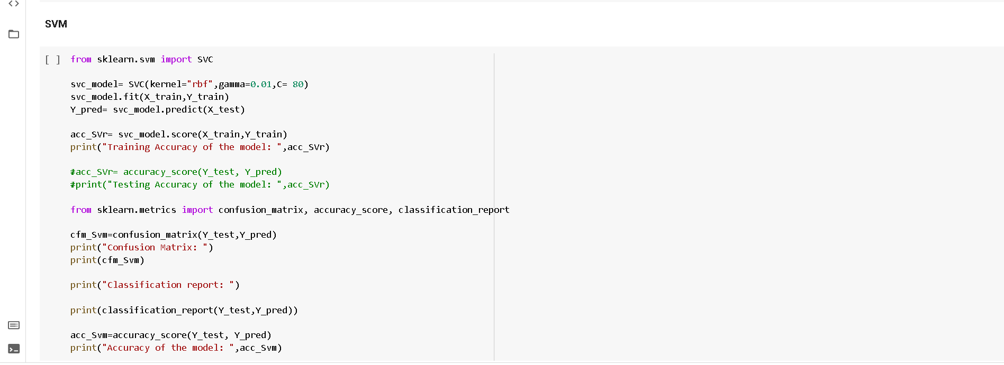
Models
BVRIT HYDERABAD College of Engineering for Women

Slide 7
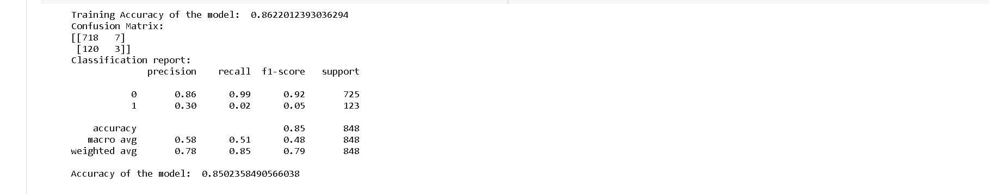
BVRIT HYDERABAD College of Engineering for Women

Slide 8
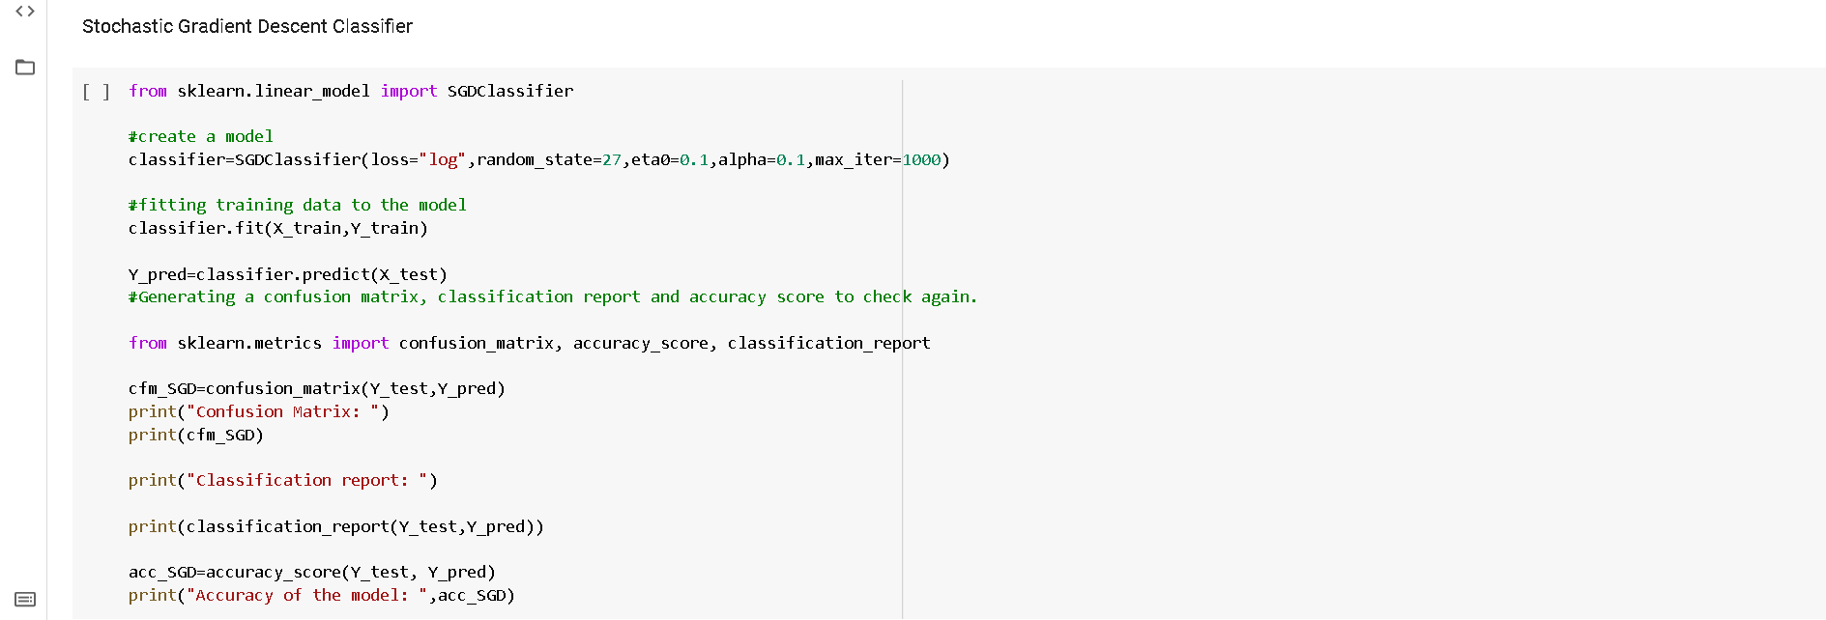
BVRIT HYDERABAD College of Engineering for Women

Slide 9
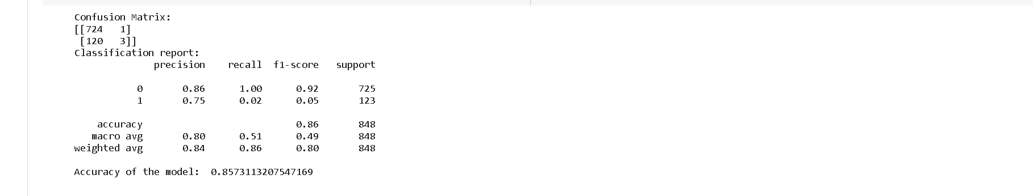
BVRIT HYDERABAD College of Engineering for Women

Slide 10
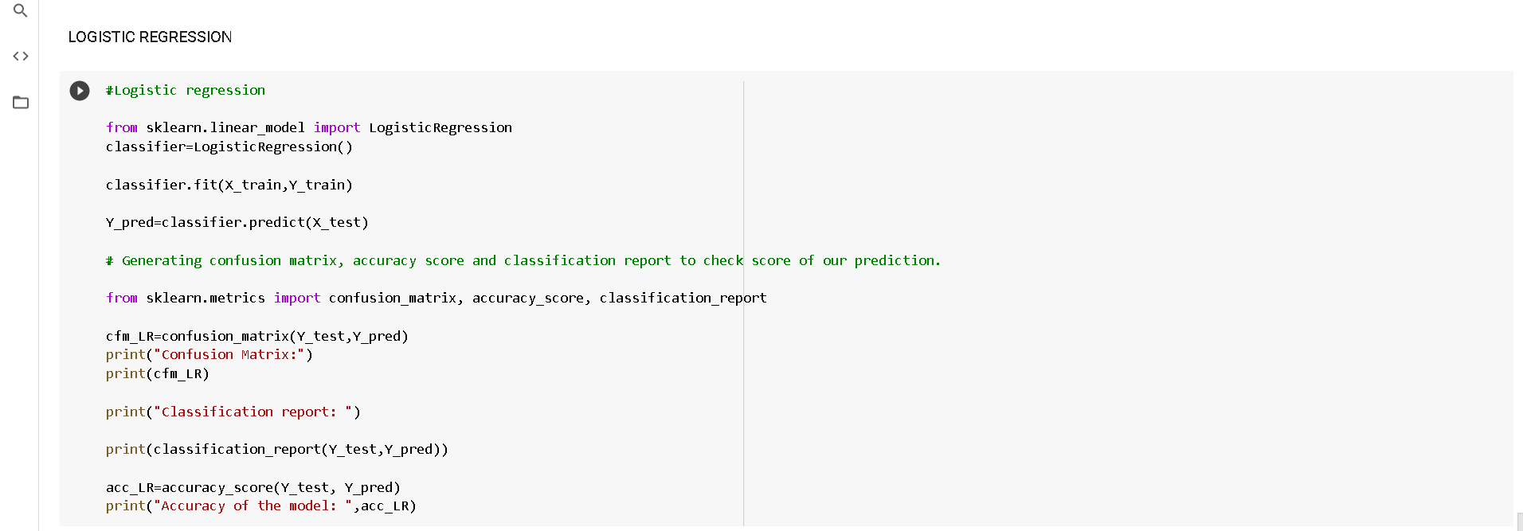
BVRIT HYDERABAD College of Engineering for Women

Slide 11
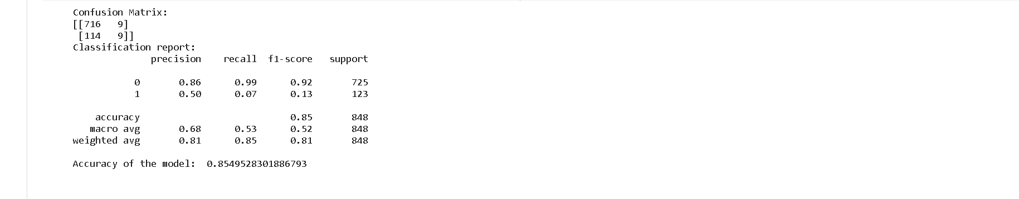
BVRIT HYDERABAD College of Engineering for Women

Slide 12
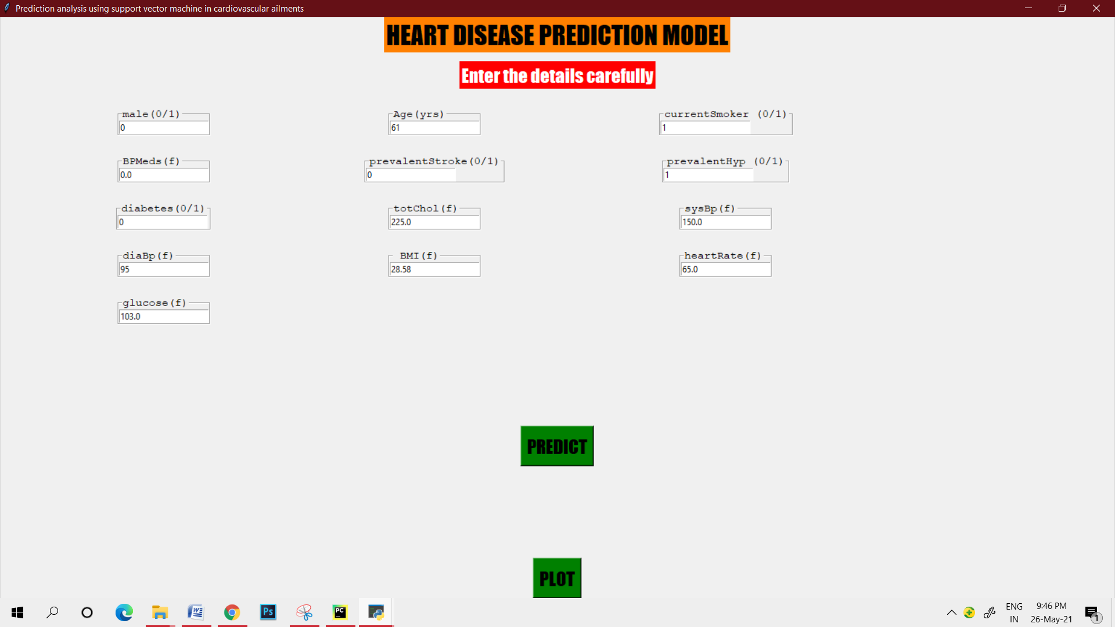
Input
BVRIT HYDERABAD College of Engineering for Women

Slide 13
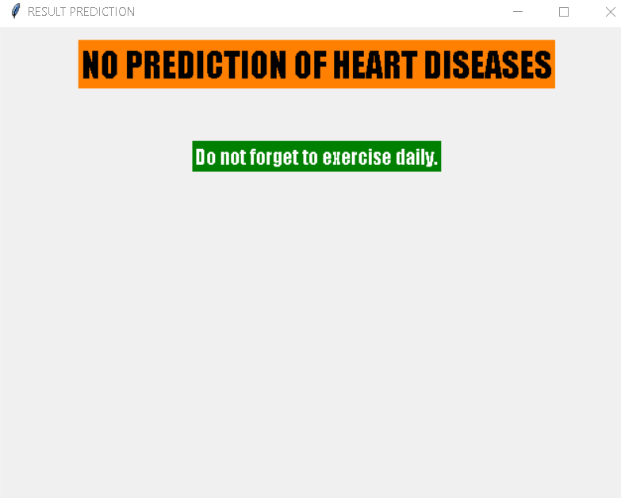
Output
BVRIT HYDERABAD College of Engineering for Women

Slide 14
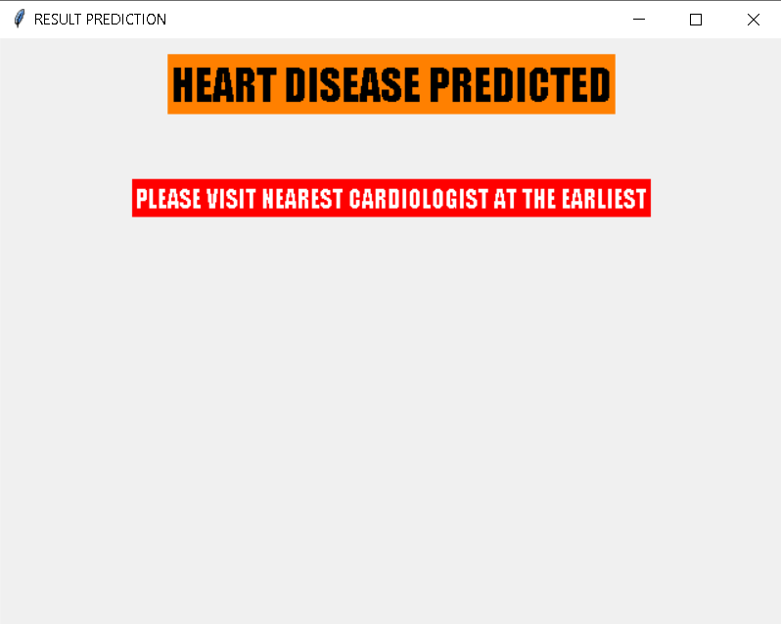
BVRIT HYDERABAD College of Engineering for Women

Slide 15
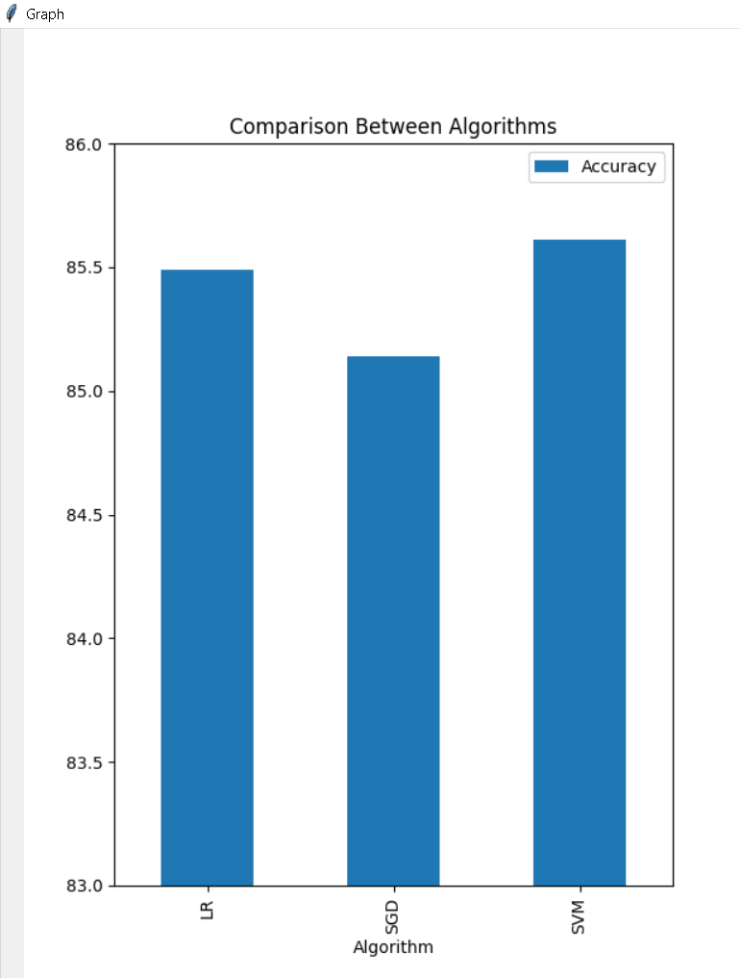
Graph
BVRIT HYDERABAD College of Engineering for Women

Slide 16
REFERENCES
1. Dhai Eddine Salhi, Abdelkamel Tari, M-Tahar Kechadi, International Conference on Computing Systems and Applications, CSA 2020: Advances in Computing Systems and Applications pp 70-81.
2. Galla Siva Sai Bindhika, Munaga Meghana(2020), "Heart Disease Prediction Using Machine Learning Techniques", (IRJET) , Volume: 07 Issue: 04.
3. " HEART DISEASE PREDICTION USING MACHINE LEARNING", International Journal of Emerging Technologies and Innovative Research (www.jetir.org), ISSN:2349-5162, Vol.7, Issue 6, page no.2081-2085, June-2020.
4. Kiranjit Kaur, Munish Saini, "HEART DISEASE PREDICTION USING MACHINE LEARNING TECHNIQUES: A SYSTEMATIC REVIEW", Vol – 15 No -5, May 2020
5. A. Lakshmanarao, Y.Swathi, P.Sri Sai Sundareswar, INTERNATIONAL JOURNAL OF SCIENTIFIC & TECHNOLOGY RESEARCH VOLUME 8, ISSUE 11, NOVEMBER 2019, Machine Learning Techniques For Heart Disease Prediction.
BVRIT HYDERABAD College of Engineering for Women

Slide 17
Thankyou
BVRIT HYDERABAD College of Engineering for Women

